Slide 1


Sproug Sprint
Dare to grow!
GDSC PoliMi 3 – Group 9

Slide 2
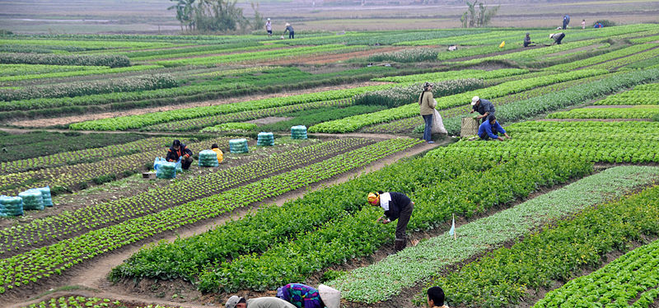

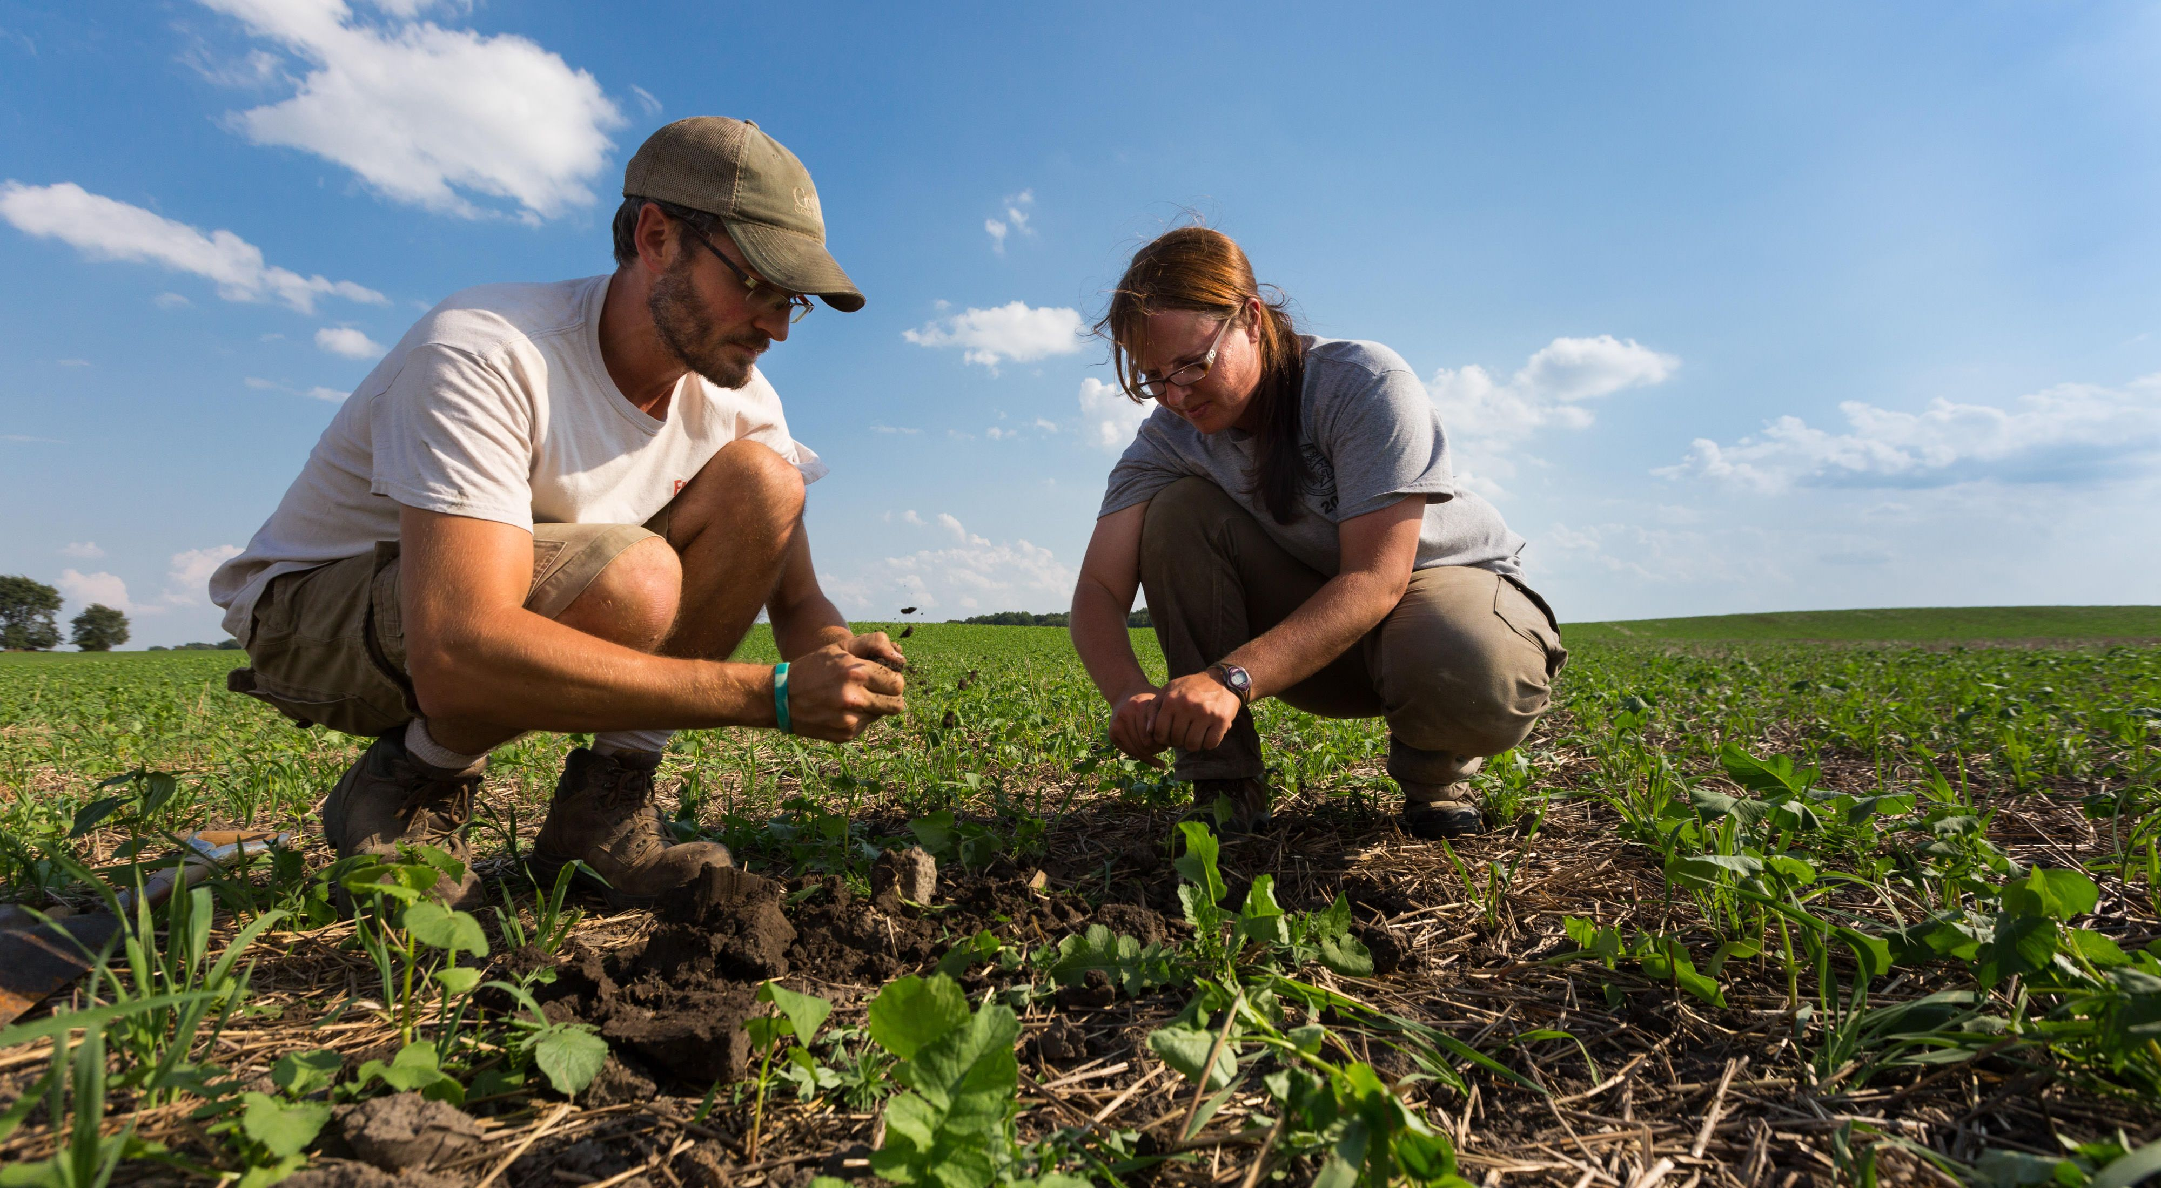
Problem
Importance of Sustainable Farming
Policymakers' Role in Sustainable Farming
Need for Increased Public Awareness

Slide 3


Solution
EduTech! Targeting
General Public, via middle school kids
Policymakers
Educators

Slide 4







Product
Educational Starter Kit
Affordable
Scalable
Fidelization

Slide 5

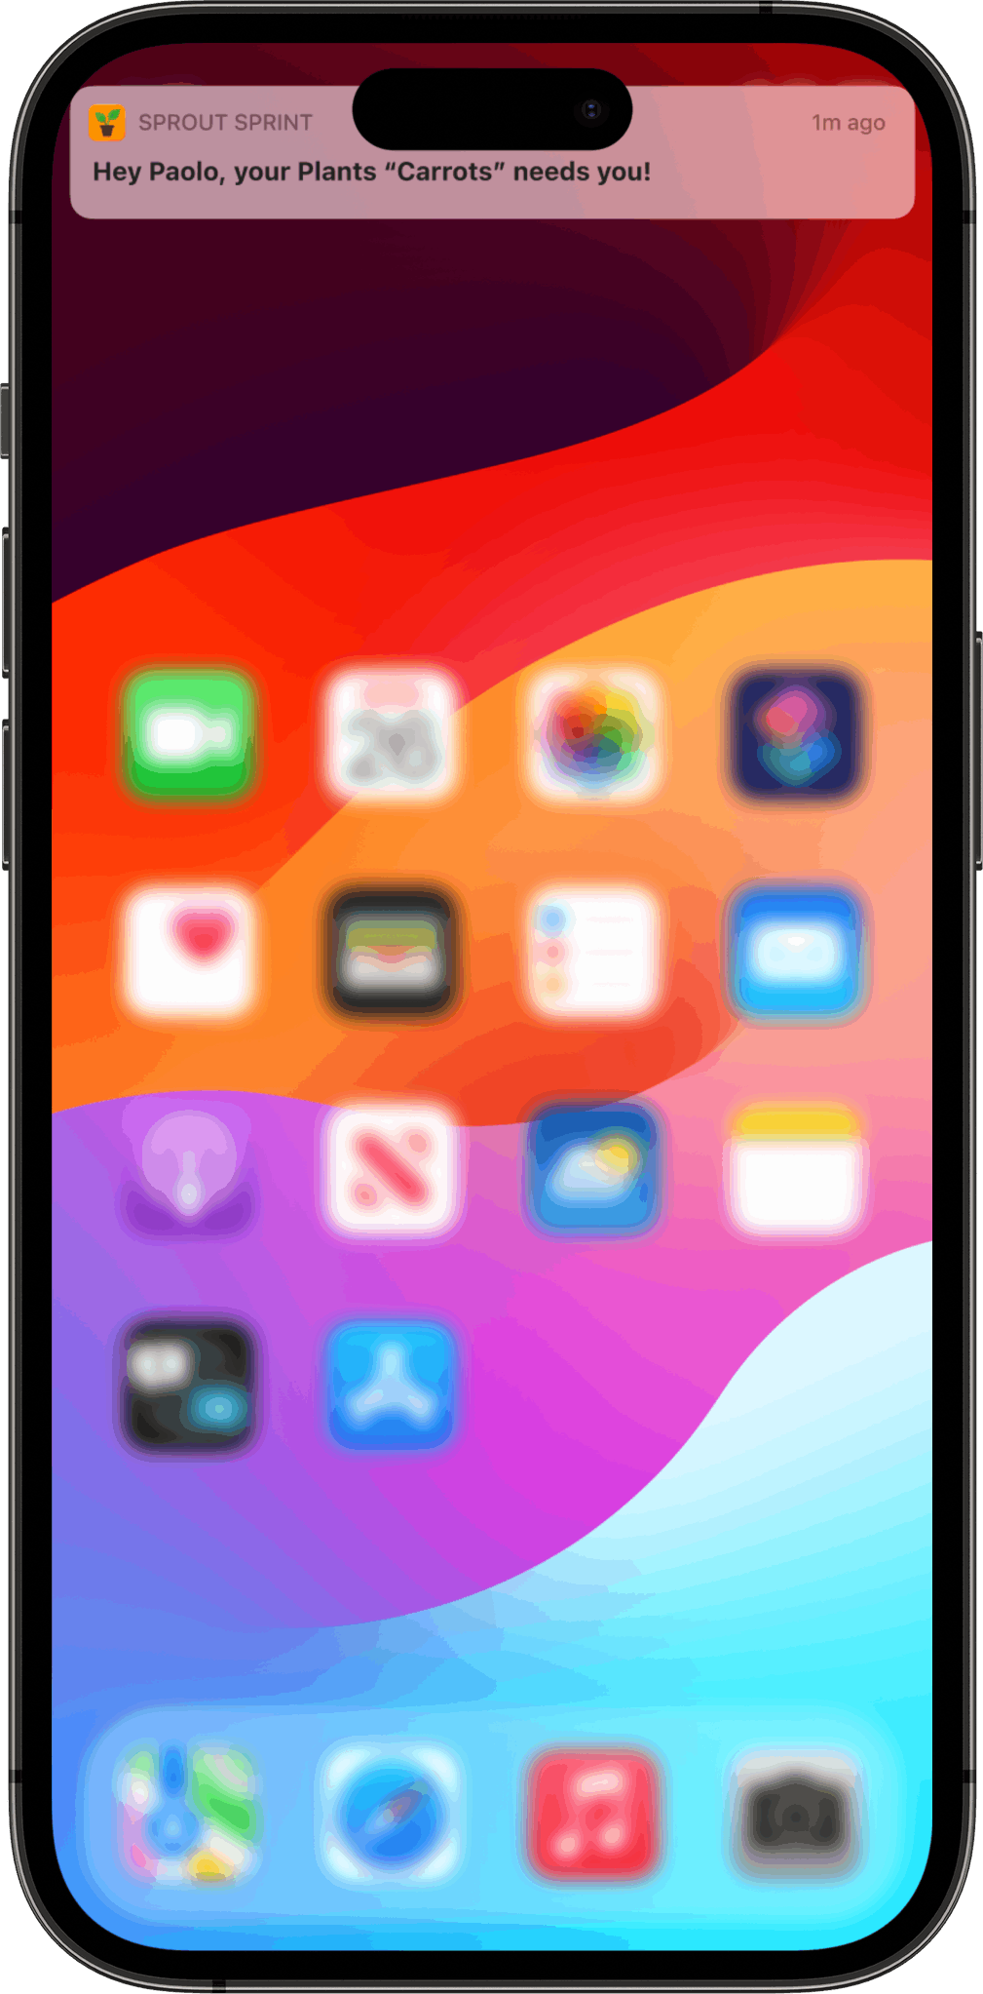

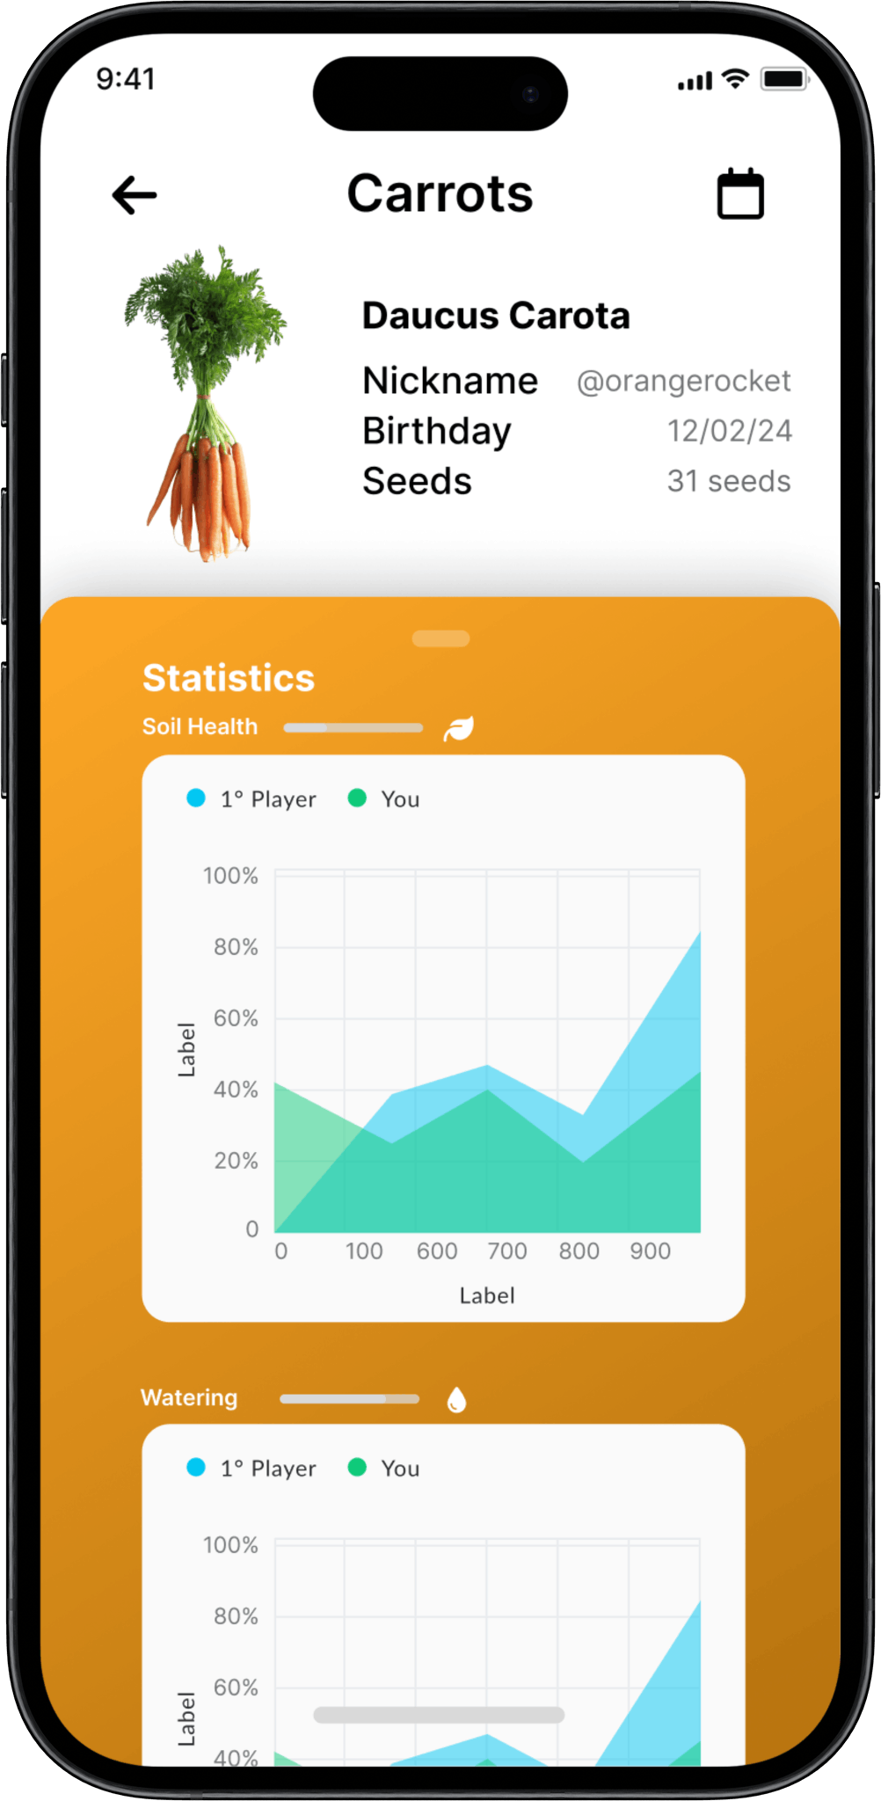
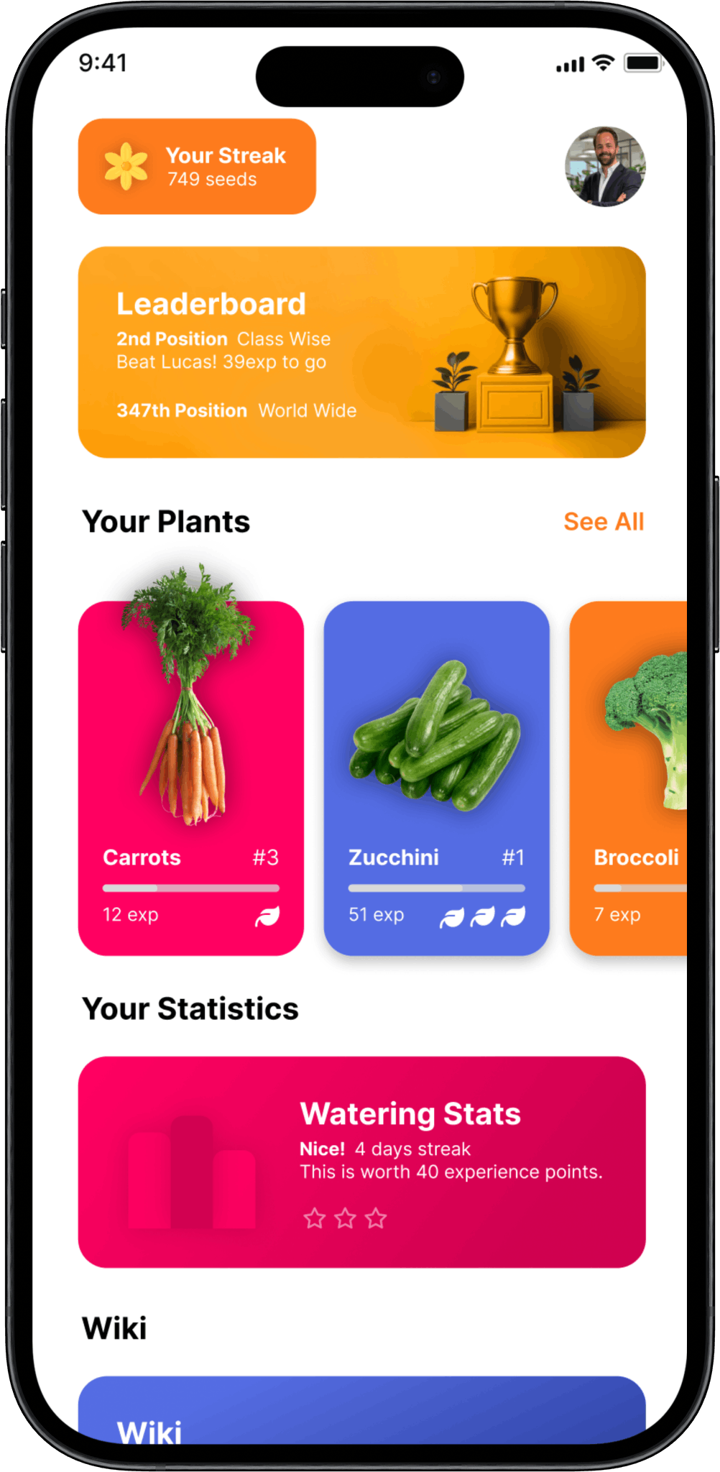
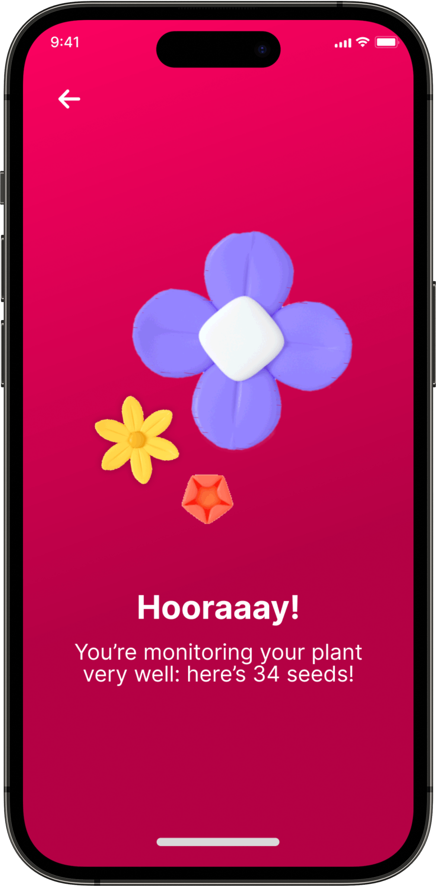
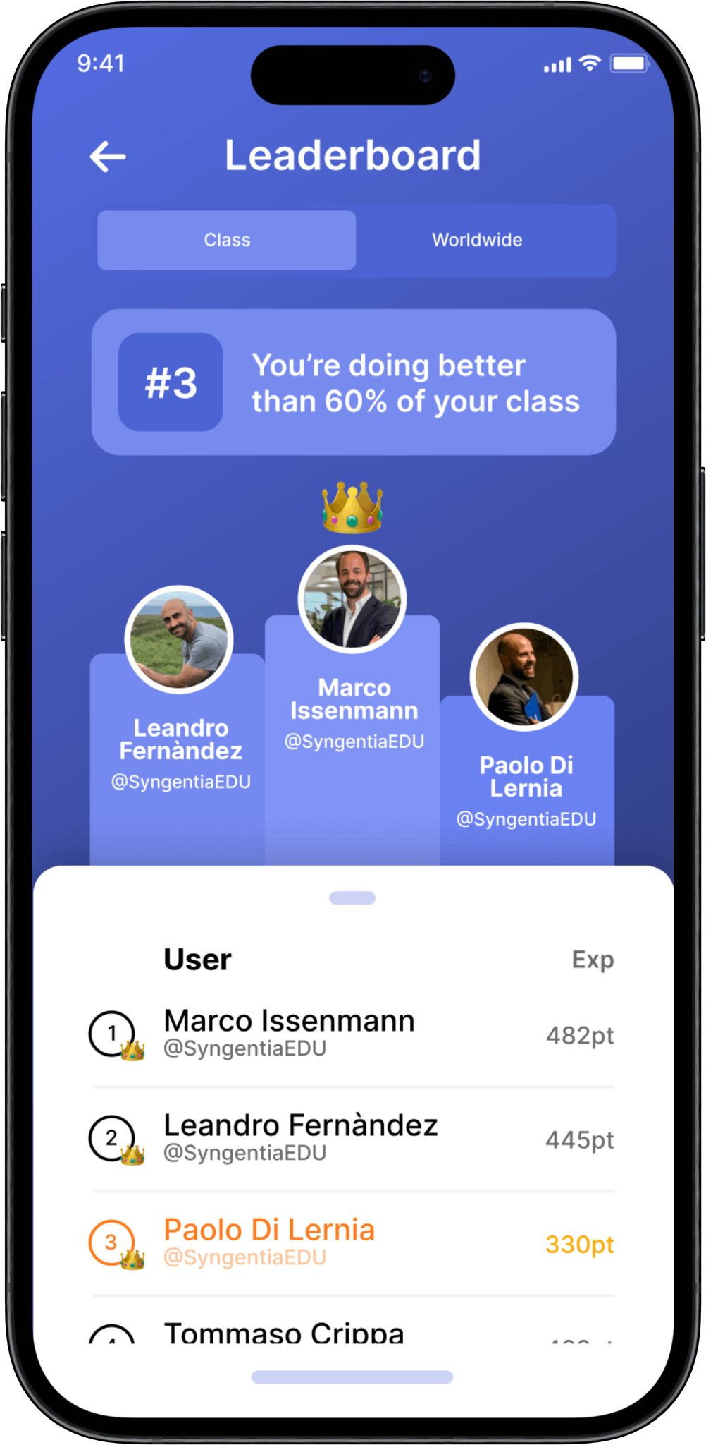


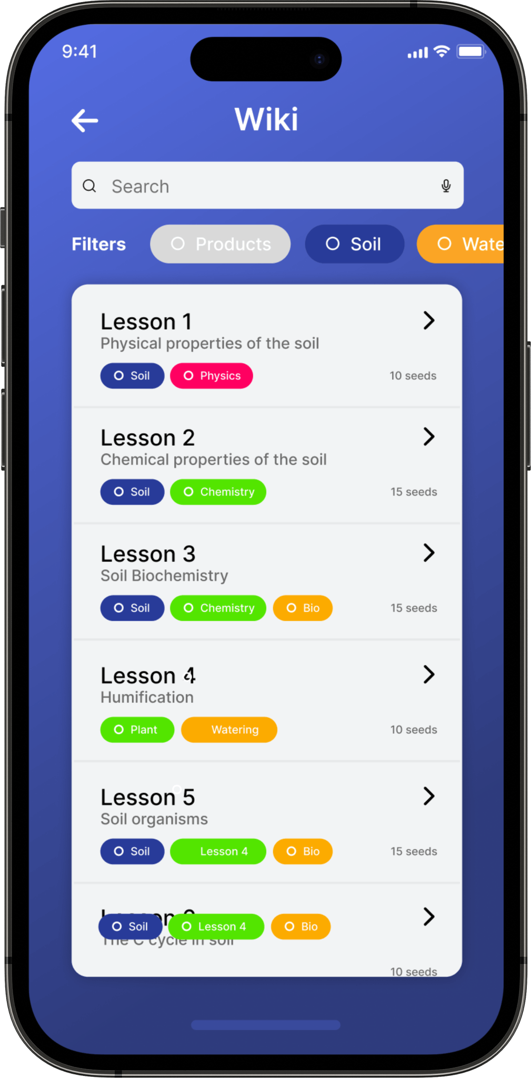

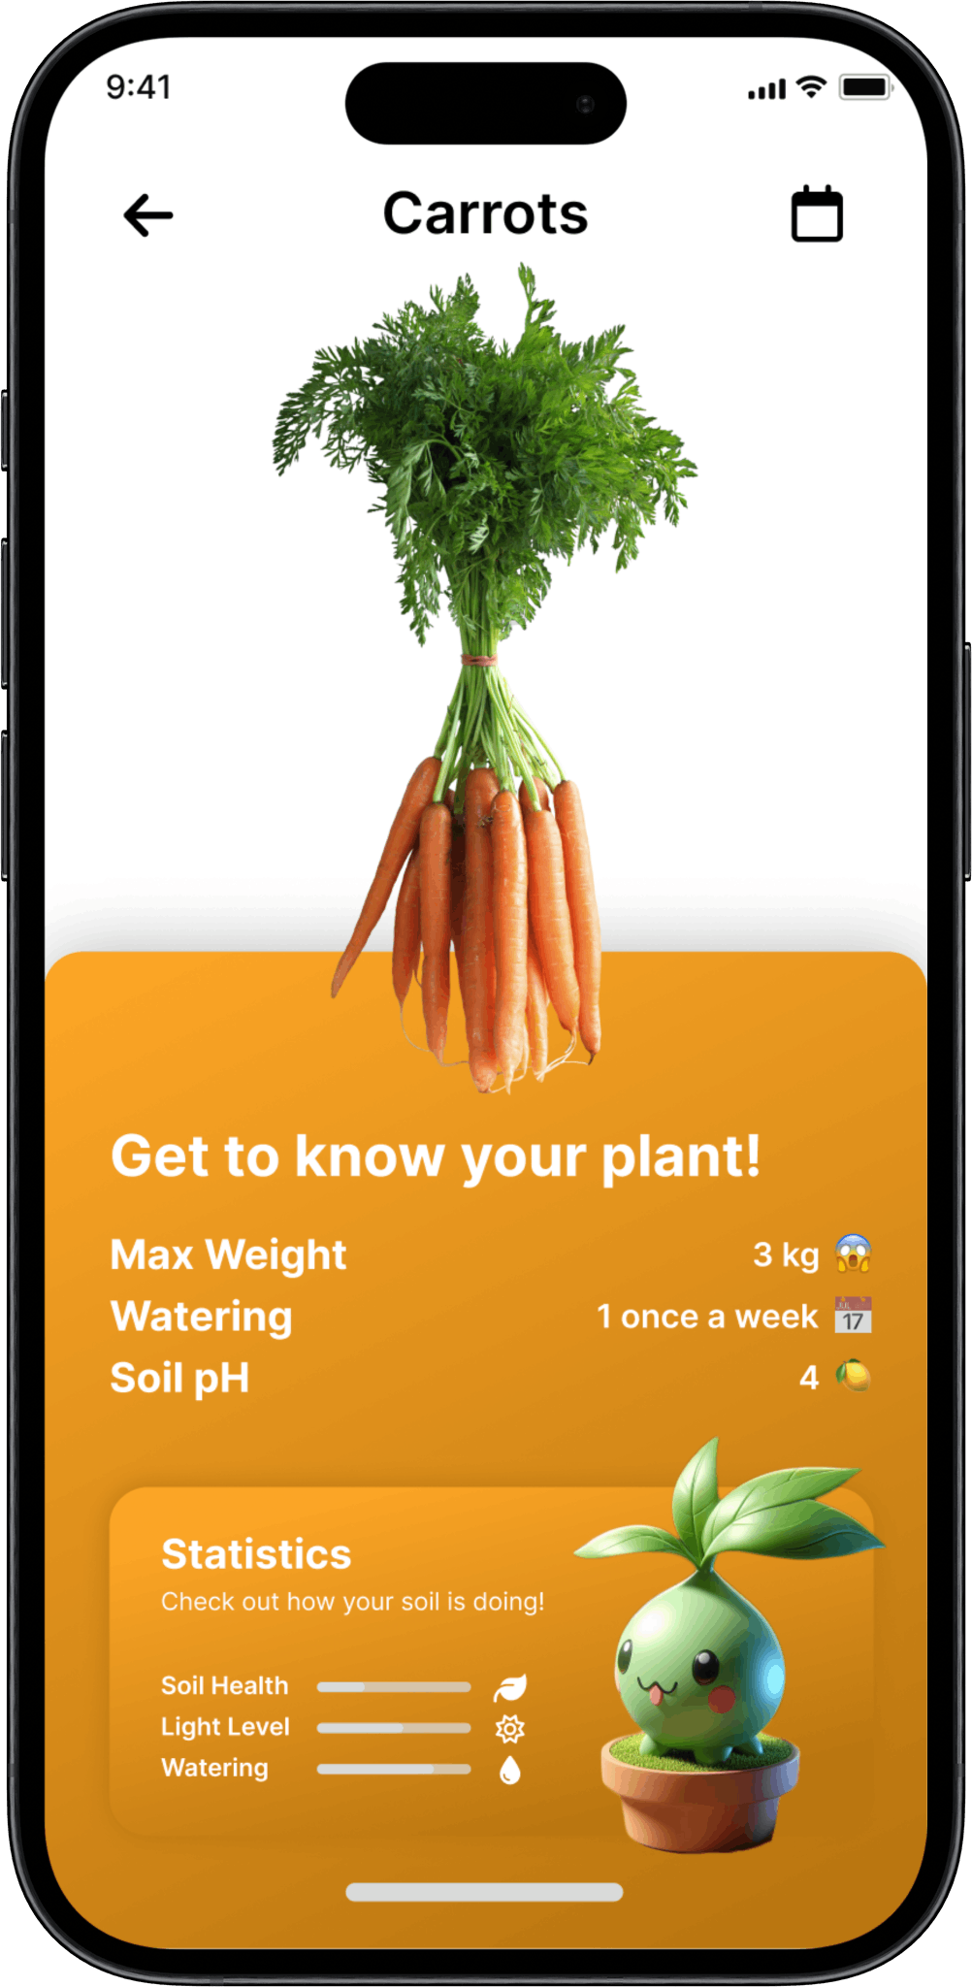

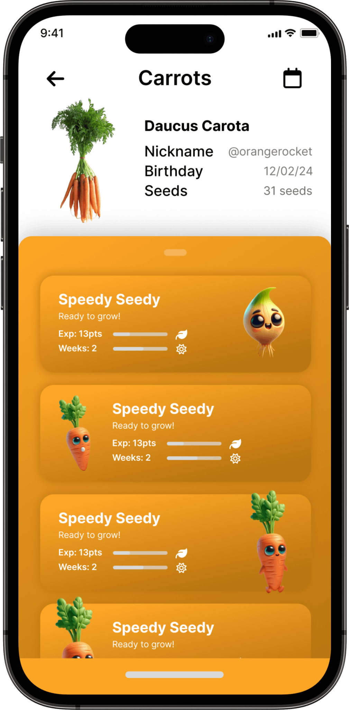
Product
Sprout Sprint Mobile App
Gamification
Leaderboard & Seeds
Learning
Lessons & Insights
Engagement
Spreading Knowledge
Rewards (convert seeds in prices)

Slide 6



Product
Backend
1. API Call
DSSAT, Forecast API, Avizio
2. Data Retrieval & Application Logic
3. Happy Plants
Happy growers!

Slide 7

Thanks!
GDSC PoliMi – Team 9
Alessandro Cogollo – alessandro.cogollo@mail.polimi.it
Tommaso Crippa – tommaso2.crippa@mail.polimi.it
Alessandro Mileto – alessandromileto22@gmail.com
Pietro Morcavallo - pietro.morcavallo@mail.polimi.it

